Slide 1
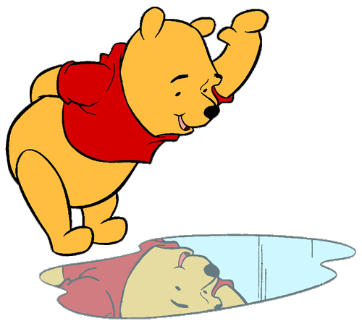
Getting to know me
ILO
Identify and name good qualities in myself and others

Slide 2
Getting to know me
Write your name in the middle of the card…

Slide 3
Getting to know me
Write your qualities around the card
If you get stuck, ask me for a list of some qualities

Slide 4
Getting to know me
Share your qualities with your partner
Choose one quality that you are happy to share with your class and write it on a little post-it.

Slide 5
Come up and each say your quality as you put it on the star…

Slide 6
Getting to know me
ILO
Identify and name good qualities in myself and others

