Slide 1
What makes a good friend?
ILO
To appreciate positive influences in our lives.

Slide 2
We practice key relationship and communication skills by talking and listening
Great for self esteem and criticism
Our friends are there when others let us down
We can learn to forgive and be forgiven
They can give us strength and help remove negative feelings about ourselves
We can take friendship for granted, because we are so comfortable with them in our lives

Slide 3
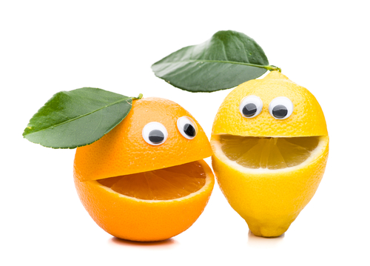
What makes a good friend?
Discuss in pairs a friendship that you each have
It doesn’t have to be with that person..
It cant be a girl/boy-friend…if you have one
The person has to be alive and a real friend…not Johnny Depp!
It cant be a pet

Slide 4
What makes a good friend?
Discuss in pairs a friendship that you each have
What does the friendship help you do, be feel, aspire to?
What do you value in the friendship?
What positive role does your friend play in your life?
How does the friendship make you feel about yourself?

Slide 5
What makes a good friend?
Discuss in pairs a friendship that you each have
Chose one of these positive qualities and write it on a post-it.
What positive role does your friend play in your life?

Slide 6
What makes a good friend?
My friend Orange knows all the bad things about me but loves me anyway

Slide 7
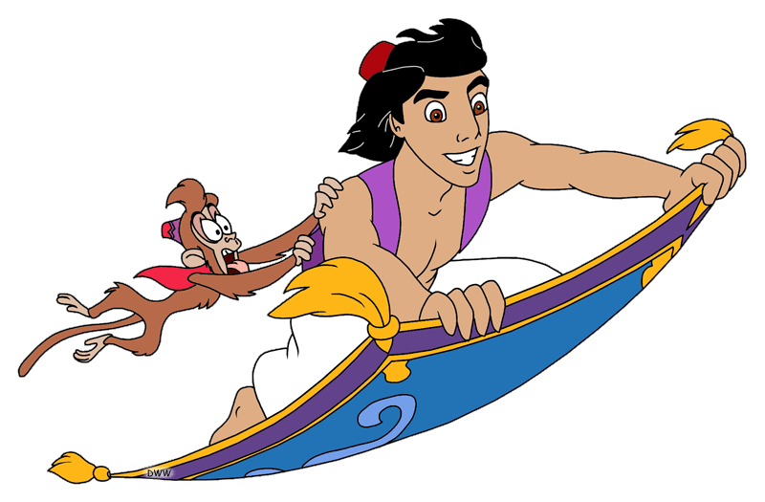
Come up and each say your friends name and their positive influence on your life when you stick your post-it on the flying carpet!

Slide 8
What makes a good friend?
ILO
To appreciate positive influences in our lives.

