Slide 1
SRE
What is SRE?
What are the statutory requirements?
How will it be ‘taught’ to pupils?

Slide 2
Sex and Relationships Education
Effective sex and relationship education is essential if young people are to make responsible and well informed decisions about their lives.
…will help young people learn to respect themselves and others and move with confidence from childhood through adolescence into adulthood…
Ofsted Curriculum and Guidance Standards 2000

Slide 3
Statistics
In May 2013, Ofsted published a report on PSHE in primary and secondary schools in England, Not yet good enough. 17 The report raised concerns about the teaching of SRE: Sex and relationships education required improvement in over a third of schools. In primary schools this was because too much emphasis was placed on friendships and relationships, leaving pupils ill-prepared for physical and emotional changes during puberty, which many begin to experience before they reach secondary school. In secondary schools it was because too much emphasis was placed on ‘the mechanics’ of reproduction and too little on relationships, sexuality, the influence of pornography on students’ understanding of healthy sexual relationships.

Slide 4
How will it be ‘taught’ to pupils?
During tutor time for year 7-10 once every half term.
SRE boxes…

Slide 5
Self Esteem
How I feel about myself
How I behave
How others Perceive and treat me

Slide 6
Topics covered
Each tutor has a box to work through |  | Boxes will be rotated
Year 7 | Year 8 | Year 9 | Year 10
Group agreement Getting to know me | Group agreement Sensory Star | Group agreement Sensory Star | Group agreement Sensory Star
What makes a good friend? | Homework feedback Getting to know me | Saying no | Sexting and the law
Sensory Star | Healthy relationships | Sexting | Saying no
Healthy relationships Conscience corridor | Giving advice (topical cards) | Healthy relationships Conscience corridor | Board game
Giving advice (topical cards) | Healthy relationships Conscience corridor | Board game | Conscience corridor
Reflection time | Reflection time | My body my rules | Scenarios and advice

Slide 7
Getting to know me…
You can choose any colour and shape.
You can use (but don’t have to!) the prompt sheet.

Slide 8
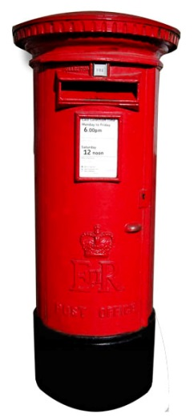
Resources…
Flying carpet…
Senses star…
I am unique and special because…
Keeping relationships

